Slide 1
Mesopotamia Vocabulary

Slide 2
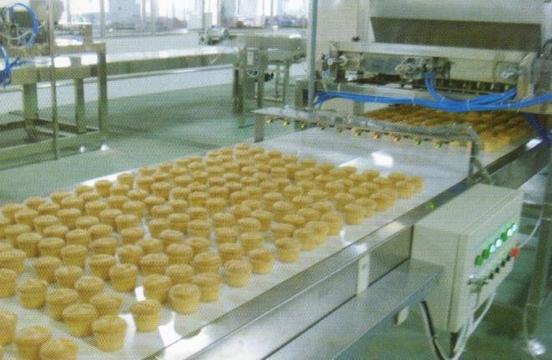
DIVISION OF LABOR
Sharing of a large job so that each worker only does part of it
“Divide and conquer”
Example: Baking – each person has a duty
Example: Washing cars
Example: Assembly lines

Slide 3
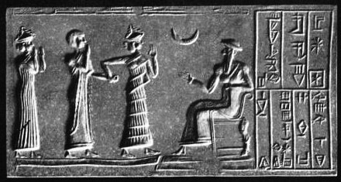
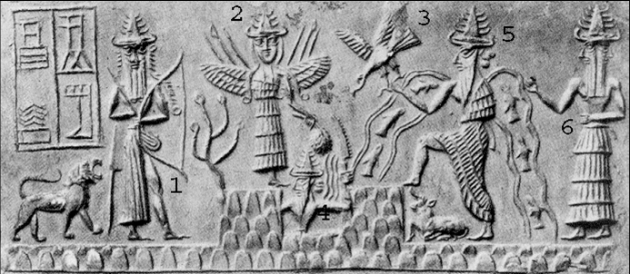
Polytheism
A belief in many gods

Slide 4
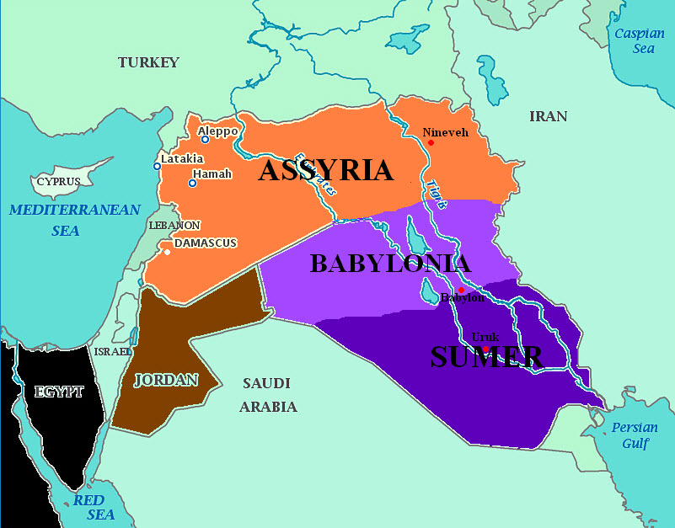
Empire
Groups of people spread across the land that come under control of a single government

Slide 5
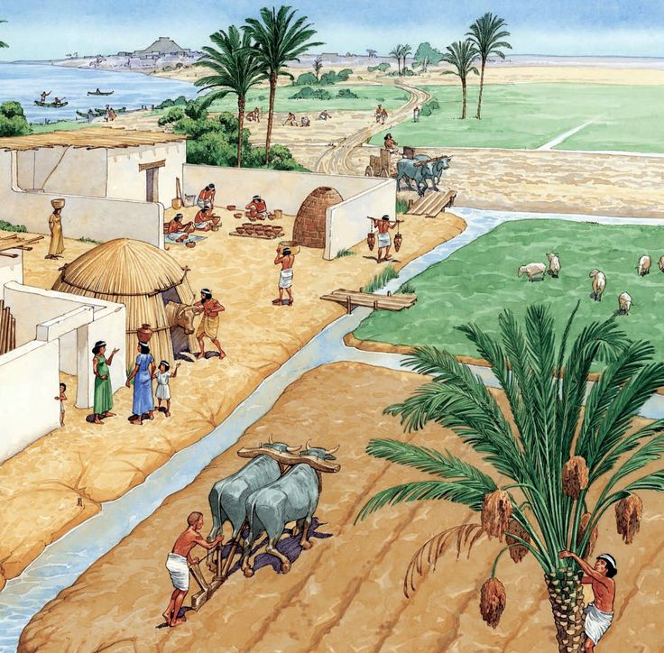
Irrigation System
The use of connected ditches, canals, or pipes to move water to dry areas

Slide 6
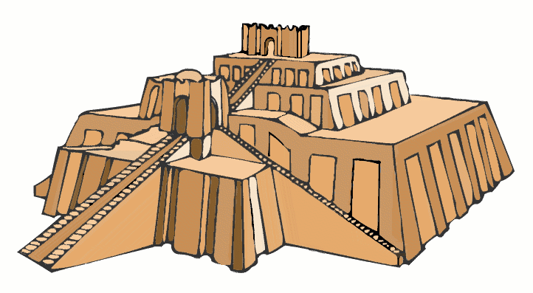
Ziggurat
A tall stepped tower built by Ancient Sumerians as a temple to a god

Slide 7
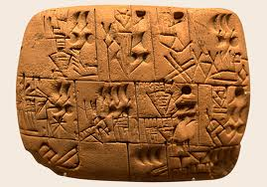
cuneiform
First system of writing using wedge shaped characters to represent meaning

Slide 8
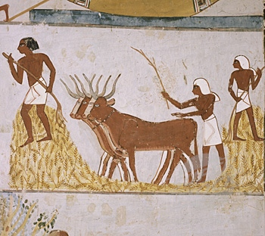
Domesticate
The raising of wild plants and animals to use for farming

Slide 9
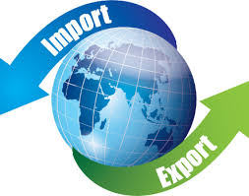
Import/Export
Import: bringing in goods to sell
Export: sending goods out to sell

